Slide 1

Buying Opportunities for the Coopers
Author – Amber Paige Webber

Slide 2
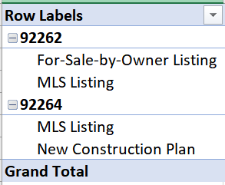
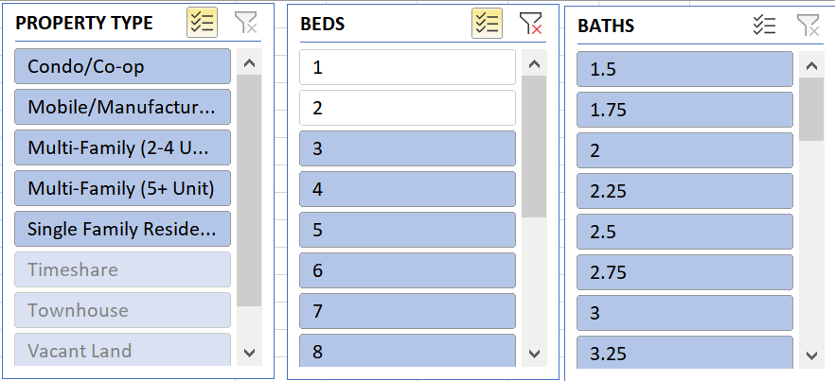
Housing Listings Data
Currently, the locations in the 92262 and 92264 zip codes have listings with the number of Beds that are part of your requirements for a place to call home.

Slide 3
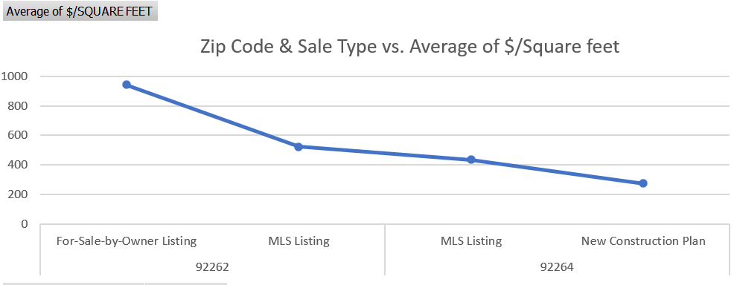

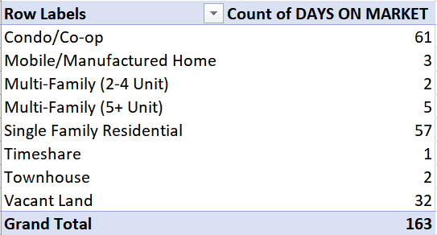
Square Feet, Listing Types, & Days on the Market
As you can see the 92262-zipcode code has listings that have a far larger amount of homes that have a square feet requirement that you are looking for.
Single family residential homes are on the market for longer than the rest of the property types, however less than two months isn’t a lot of time relative to the buyer looking.

Slide 4
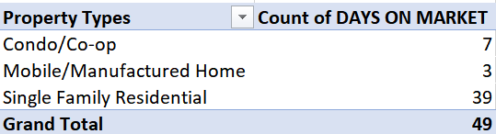
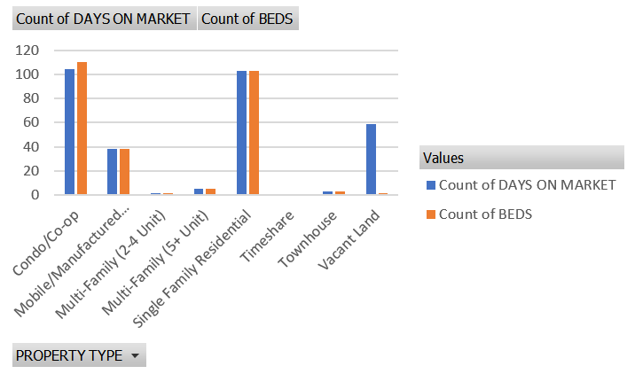
Number of Bedrooms, Number of Days on the Market
The number of beds correlate to the number of days a given property type is on the market. So, while not rushing seems like a good idea, we should consider the limitations elsewhere.

Slide 5
Limitations
Let’s focus on the 99262 Zip Code, since that has the most $/Square Feet. You want to have more room in case you grow your family within the next 5-years. Let’s look at options that reflect that .
Cooper’s Budget: $700,000
321 Listings under the Cooper’s Budget for buying within either the 99262 or 99264 zip code.

Slide 6
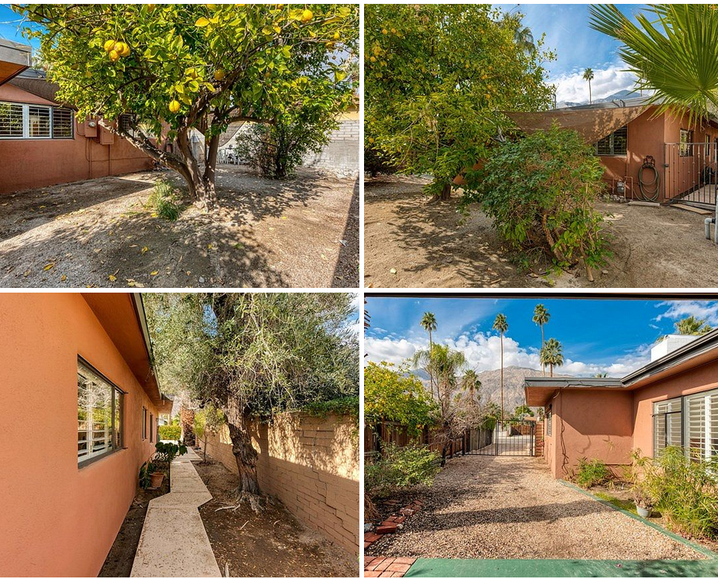
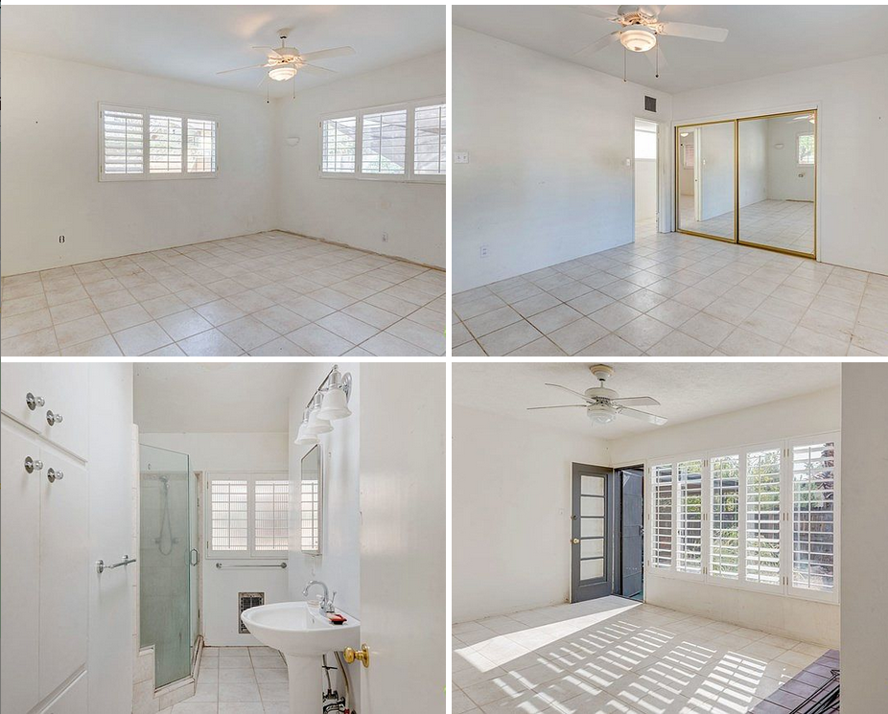
Option #1: Below $700,000, only 3-days on Zillow, 3-bed, 2 bath… 92264

Slide 7
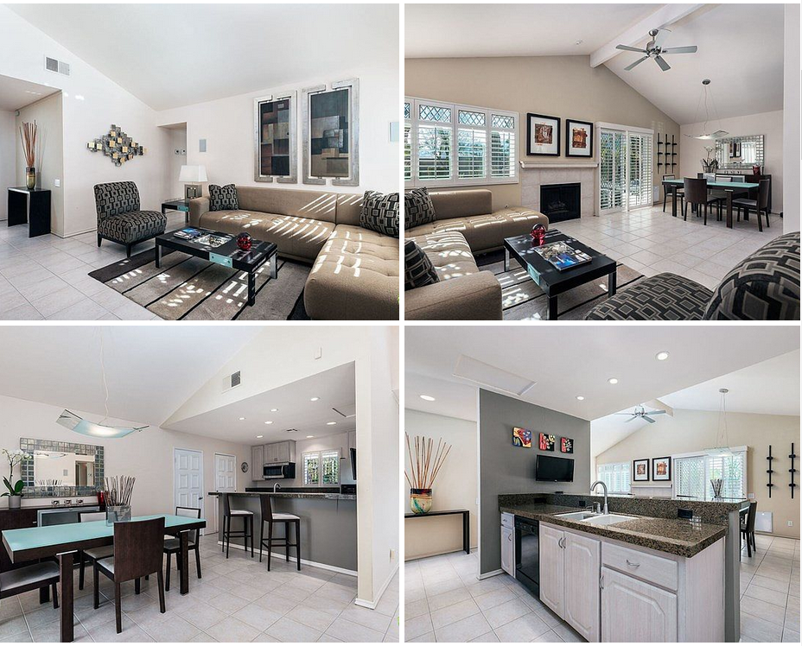
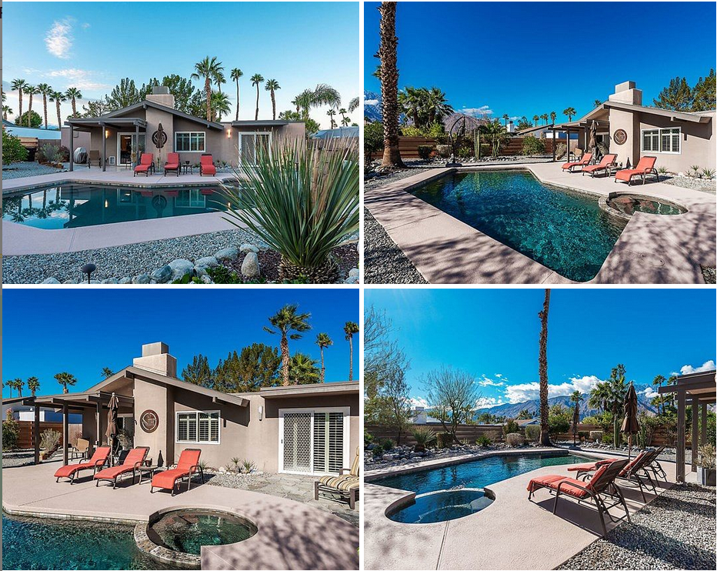
Option #2: 92262 3 bedroom, 2 baths, below the budget… $499,000
Single Family Style Home
Built in 1982

Slide 8

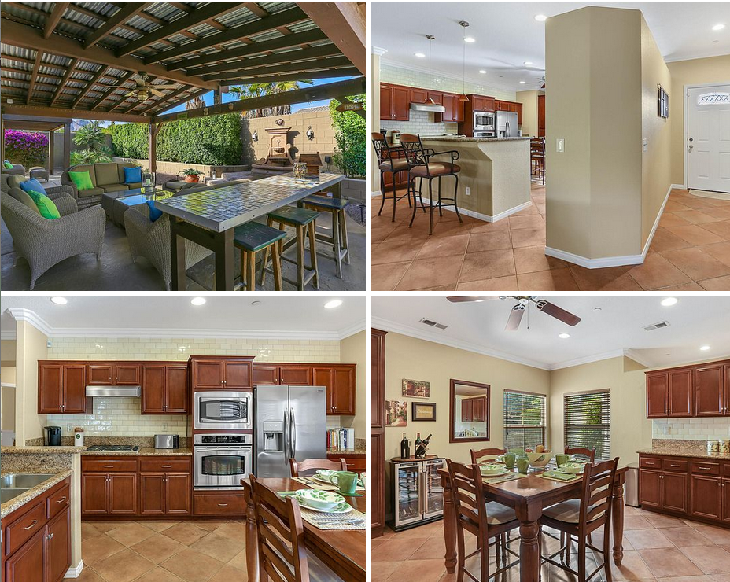
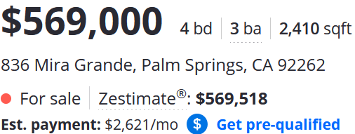
An amazing deal! Below budget, more bedrooms and bathrooms than requirement and HOA is only $120 per month… (Option 3)

Slide 9
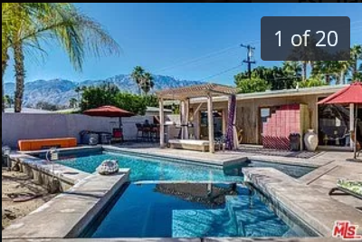
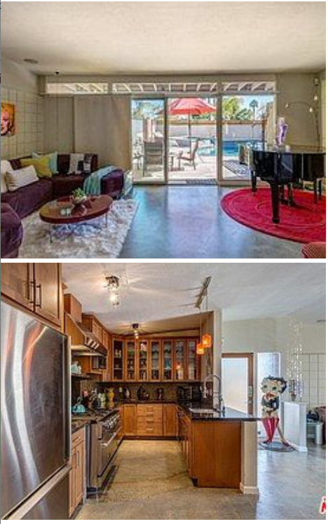
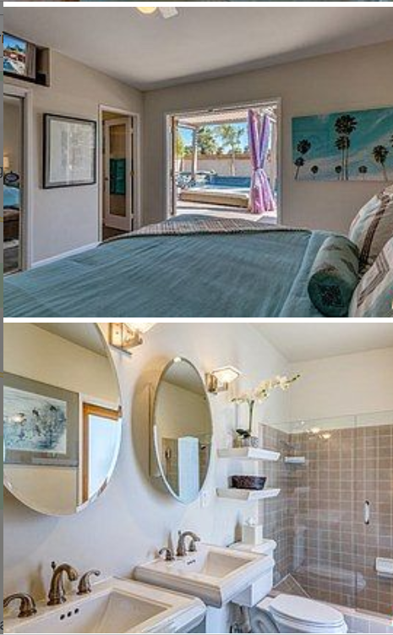
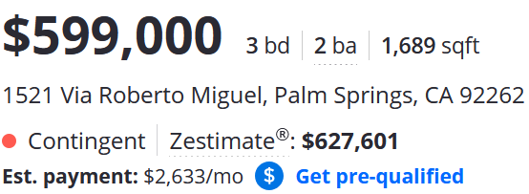
Let’s get to what works best for you…
Option 4…
92262

Slide 10
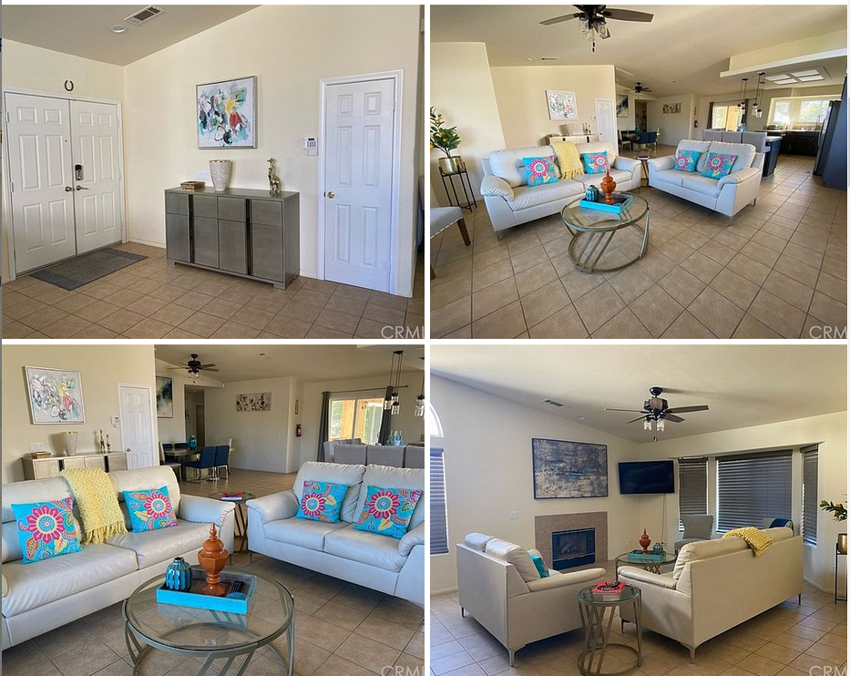
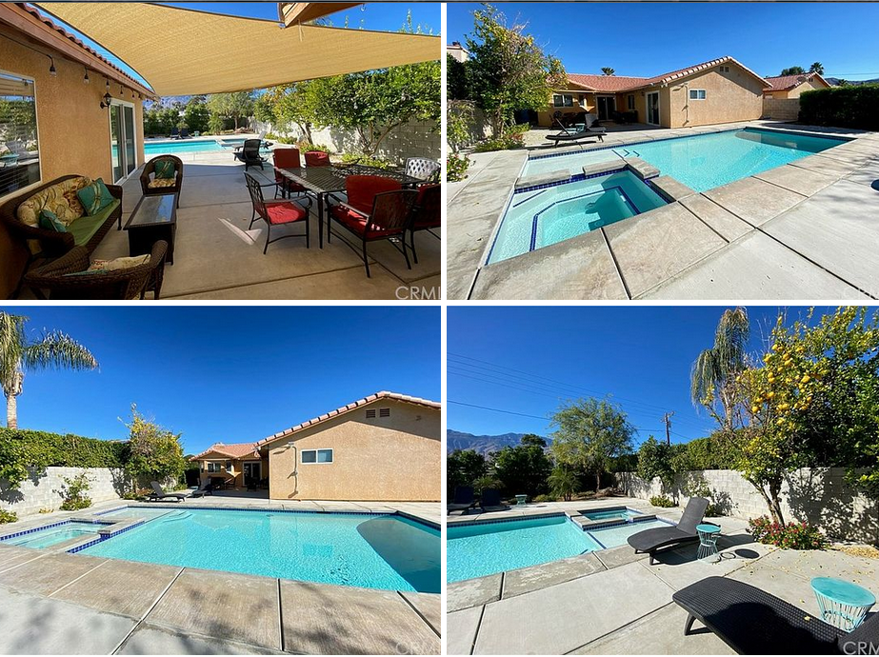
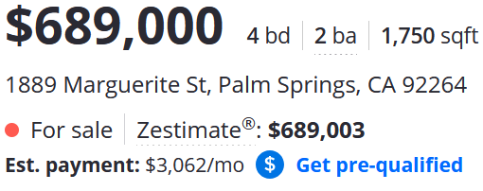
Which one of these recommendations are best for your present and your future…?
92264
Below $700,000, 4-Bedrooms…

Slide 11
Feedback Score / 20
Complete requested technical work in Excel: /10
Zip Code Analysis
Property Type Analysis
Additional Analysis 1
Additional Analysis 2
Use of slicers/filters and appropriate visualizations
Professional Presentation and Analysis: /10
Client Introduced
Presentation Tells A Story
Final Recommendation Supported by Data and Visualizations
Professional Slides

